Slide 1
1

Slide 2
2

Slide 3
Time to Thaw the Freeze
3

Slide 4
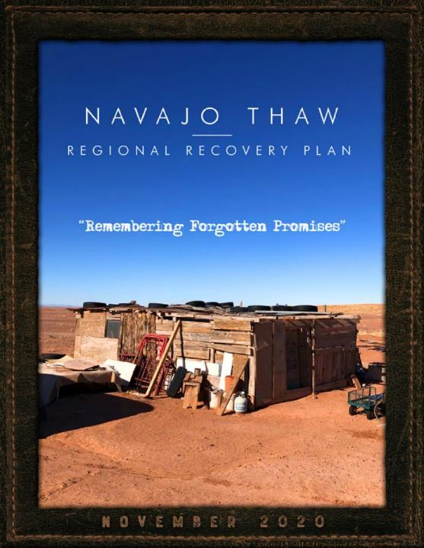
4

Slide 5
In 2020, over 600 Navajo people came together, resulting in a 116-page Regional Recovery Plan presenting a
three-phased, 10-year, $4 billion investment strategy to address the impacts of the Bennett Freeze and Forced Relocation
5

Slide 6
The plan also calls for the repurposing of a federal office to help Navajo communities build:
Housing
Infrastructure
Public Facilities
Economic Enterprise
In 2020, over 600 Navajo people came together, resulting in a 116-page Regional Recovery Plan presenting a
three-phased, 10-year, $4 billion investment strategy to address the impacts of the Bennett Freeze and Forced Relocation
6

Slide 7
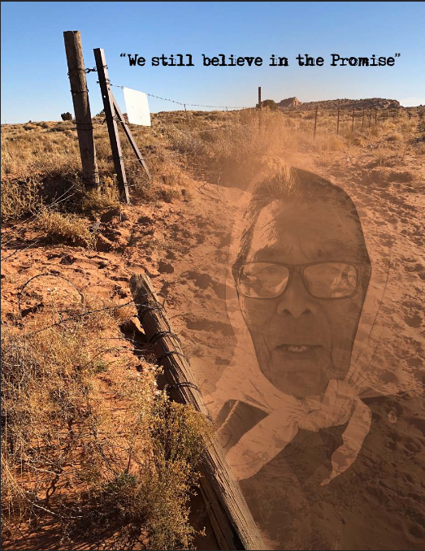
It Doesn’t Have to Remain this Way
Still Hope for the Future
7

Slide 8
FOUR PART PRESENTATION
1—Purpose
2—Request
3—Progress
4—Plan
8

Slide 9
FOUR PART PRESENTATION
1—Purpose
2—Request
3—Progress
4—Plan
9

Slide 10
1—Purpose
To develop and implement 10 Chapter Recovery Plans and one Navajo Thaw Regional Recovery Plan to address the impacts of the Bennett Freeze and Forced Relocation.
10

Slide 11
1—Purpose
Create a sustainable future, while providing funding for Housing Infrastructure Public Facilities Economic Development (Jobs)
11

Slide 12
FOUR PART PRESENTATION
1—Purpose
2—Request
3—Progress
4—Plan
12

Slide 13
FOUR PART PRESENTATION
1—Purpose
2—Request
3—Progress
4—Plan
13

Slide 14
4 Actions Needed
Immediate action is needed to begin to implement the Navajo Thaw Regional Recovery Plan: Funding—Appropriate $200 million to fund the first of three phases of the Plan. These funds would be spent in 2021-2022 to complete Immediate Recovery Projects and to conduct the design/engineering/environmental-clearance work to construct Phase II projects. Authority—Repurpose ONHIR so that it becomes the Office of Navajo and Hopi Indian Recovery; create a powerful Navajo oversight body over ONHIR to implement the Navajo Thaw Regional Recovery Plan. Technical Amendments—Approve amendments to Public Law 93–531 relating to lands of the Navajo Nation and for other purposes. NPL—Develop and implement a plan, like the scope and purpose focused upon the Former Bennett Freeze Area, to develop housing, infrastructure, public facilities, and economic development.
www.NavajoThaw.com
2—Request
14

Slide 15
4 Actions Needed
Immediate action is needed to begin to implement the Navajo Thaw Regional Recovery Plan: Funding—Appropriate $200 million to fund the first of three phases of the Plan. These funds would be spent in 2021-2022 to complete Immediate Recovery Projects and to conduct the design/engineering/environmental-clearance work to construct Phase II projects. Authority—Repurpose ONHIR so that it becomes the Office of Navajo and Hopi Indian Recovery; create a powerful Navajo oversight body over ONHIR to implement the Navajo Thaw Regional Recovery Plan. Technical Amendments—Approve amendments to Public Law 93–531 relating to lands of the Navajo Nation and for other purposes. NPL—Develop and implement a plan, like the scope and purpose focused upon the Former Bennett Freeze Area, to develop housing, infrastructure, public facilities, and economic development.
www.NavajoThaw.com
2—Request
15

Slide 16
4 Actions Needed
Immediate action is needed to begin to implement the Navajo Thaw Regional Recovery Plan: Funding—Appropriate $200 million to fund the first of three phases of the Plan. These funds would be spent in 2021-2022 to complete Immediate Recovery Projects and to conduct the design/engineering/environmental-clearance work to construct Phase II projects. Authority—Repurpose ONHIR so that it becomes the Office of Navajo and Hopi Indian Recovery; create a powerful Navajo oversight body over ONHIR to implement the Navajo Thaw Regional Recovery Plan. Technical Amendments—Approve amendments to Public Law 93–531 relating to lands of the Navajo Nation and for other purposes. NPL—Develop and implement a plan, like the scope and purpose focused upon the Former Bennett Freeze Area, to develop housing, infrastructure, public facilities, and economic development.
www.NavajoThaw.com
2—Request
16

Slide 17
4 Actions Needed
Immediate action is needed to begin to implement the Navajo Thaw Regional Recovery Plan: Funding—Appropriate $200 million to fund the first of three phases of the Plan. These funds would be spent in 2021-2022 to complete Immediate Recovery Projects and to conduct the design/engineering/environmental-clearance work to construct Phase II projects. Authority—Repurpose ONHIR so that it becomes the Office of Navajo and Hopi Indian Recovery; create a powerful Navajo oversight body over ONHIR to implement the Navajo Thaw Regional Recovery Plan. Technical Amendments—Approve amendments to Public Law 93–531 relating to lands of the Navajo Nation and for other purposes. NPL—Develop and implement a plan, like the scope and purpose focused upon the Former Bennett Freeze Area, to develop housing, infrastructure, public facilities, and economic development.
www.NavajoThaw.com
2—Request
17

Slide 18
4 Actions Needed
Immediate action is needed to begin to implement the Navajo Thaw Regional Recovery Plan: Funding—Appropriate $200 million to fund the first of three phases of the Plan. These funds would be spent in 2021-2022 to complete Immediate Recovery Projects and to conduct the design/engineering/environmental-clearance work to construct Phase II projects. Authority—Repurpose ONHIR so that it becomes the Office of Navajo and Hopi Indian Recovery; create a powerful Navajo oversight body over ONHIR to implement the Navajo Thaw Regional Recovery Plan. Technical Amendments—Approve amendments to Public Law 93–531 relating to lands of the Navajo Nation and for other purposes. NPL—Develop and implement a plan, like the work focused upon the Former Bennett Freeze Area, to develop housing, infrastructure, public facilities, and economic development.
www.NavajoThaw.com
2—Request
18

Slide 19
FOUR PART PRESENTATION
1—Purpose
2—Request
3—Progress
4—Plan
19

Slide 20
FOUR PART PRESENTATION
1—Purpose
2—Request
3—Progress
4—Plan
20

Slide 21
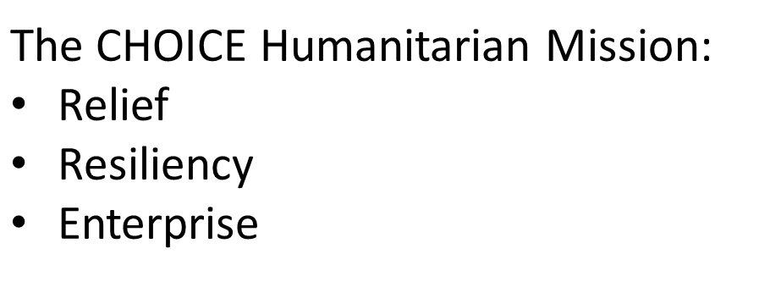
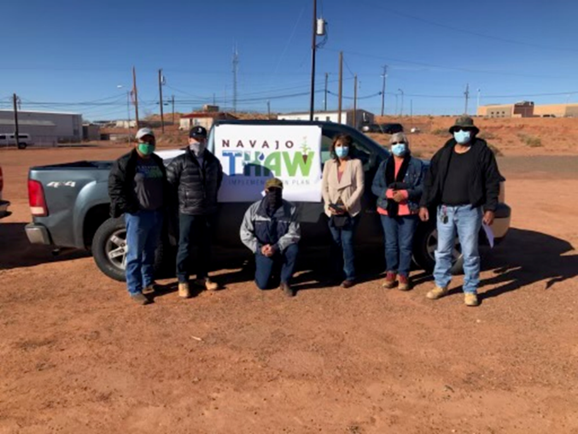
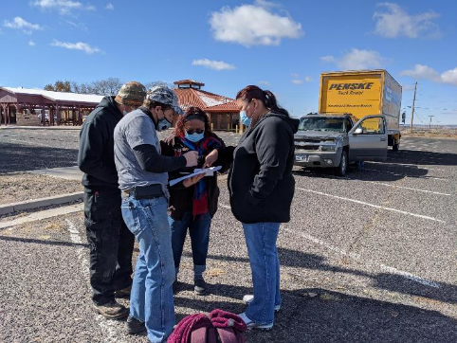
Partnership with International Non-profit: CHOICE Humanitarian
21

Slide 22
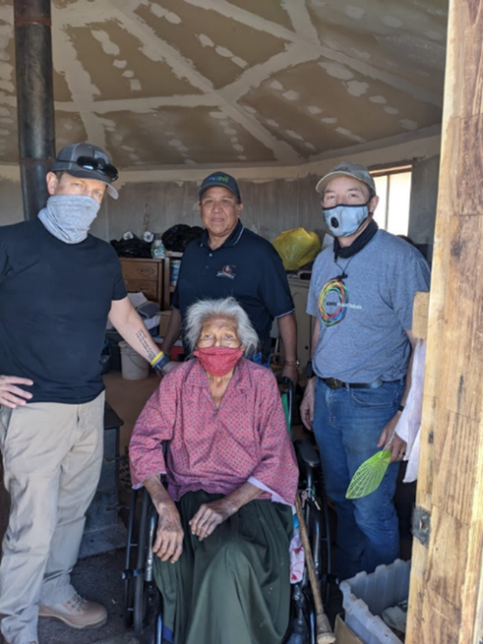
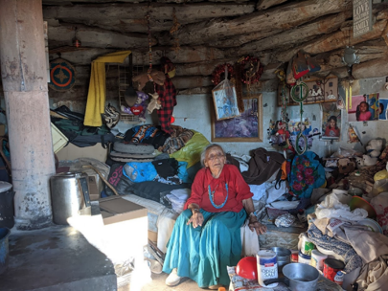
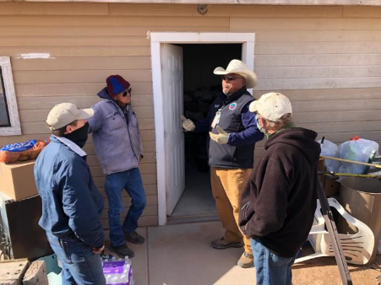
Mobilizing the Navajo Thaw
22

Slide 23
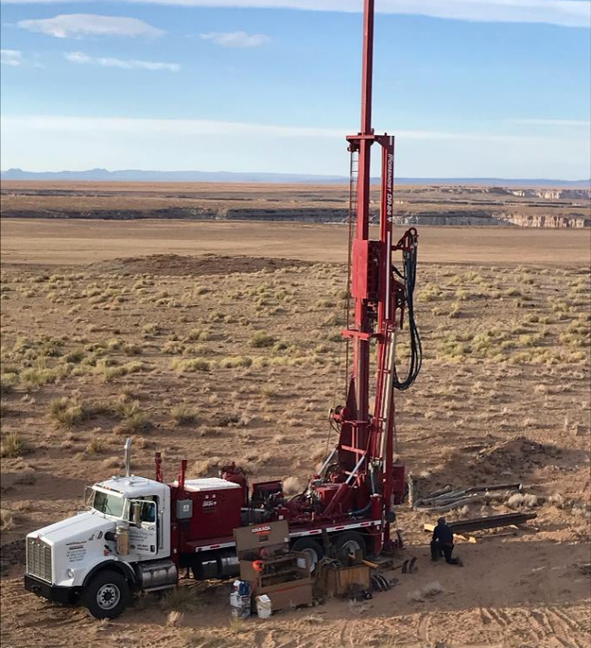
Tolani Lake Enterprises COVID Relief
23

Slide 24
Tolani Lake Enterprises COVID Relief
Tolani Lake Enterprises (TLE) has worked closely since June 2020 with the Navajo Nation Water Resources Department, Office of Navajo-Hopi Land Development, and BIA (Western Agency) to plan and implement a Covid Relief and Recovery Water and Food Security initiative.
* Six wells have been completed, with good quality water available for all community uses:
Cameron Old Farm 1 Teesyahotyeel 2 (two test)
Black Falls 2 (two test) North Leupp 1 (test)
* The Black Falls wells are the first water sources ever developed for that community!
* Teesyahotyeel and North Leupp wells are test wells for Navajo Nation Water Resources
* Six additional wells will be drilled and completed and equipped by December 30
Black Falls 1 (production)
Beaver Farm (Leupp) 2 (one test, one production)
Coalmine Canyon 1 deep production well
Tuba City/Kerley Valley 2 (one test, one production)
24

Slide 25
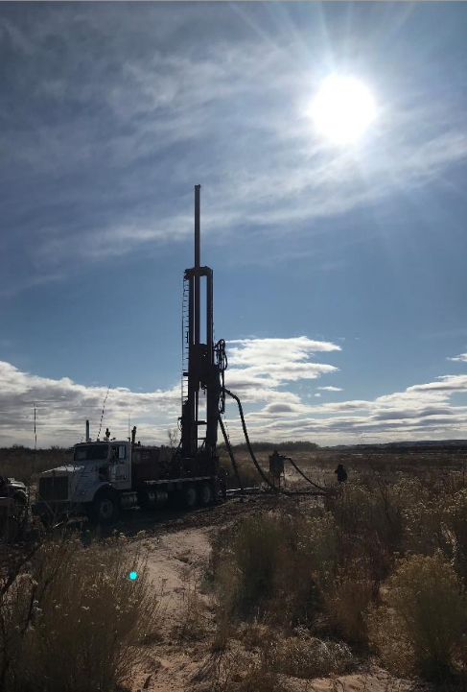
Tolani Lake Enterprises COVID Relief
* Each production well is being pump tested, water quality analyses conducted and reported, and wells fit with pump, power source, security fence, pipeline, 25,000 gallon water tank, and watering point. Test wells with adequate good quality water (Teesyahotyeel, Black Falls) are also being pumped to water tanks for community use.
* 30 roof-top water catchments with tanks and filters have been installed on at least 30 homes in 10 communities, to provide safe water for needy families; at least 30 more systems will be installed before the end of December.
25

Slide 26
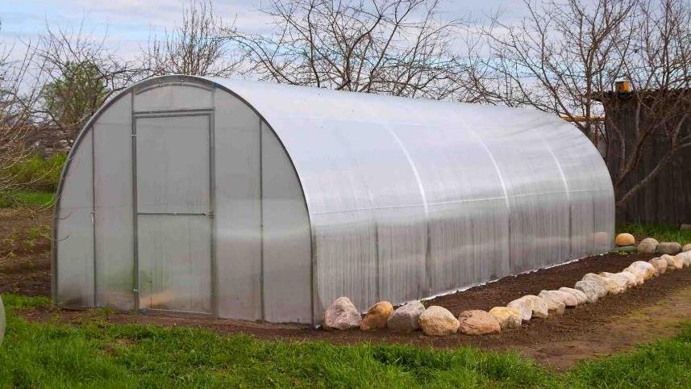
Tolani Lake Enterprises COVID Relief
* Eight hoophouses are growing high quality food in seven communities (Leupp, Cameron, Teesto, Dilkon, Tolani Lake, Ganado, Birdsprings); distribution to needy families has started and will continue into 2021
* Community teams, growers, and contract engineers, hydrologists, solar installers and others are working seven days a week to complete this work by December 30, as per Agreement with the Navajo Nation.
26

Slide 27
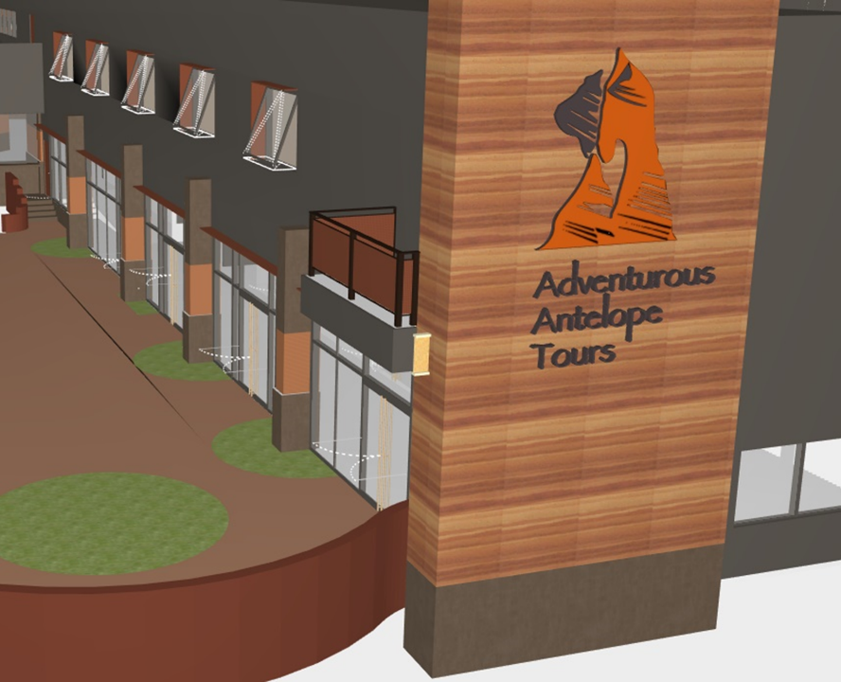
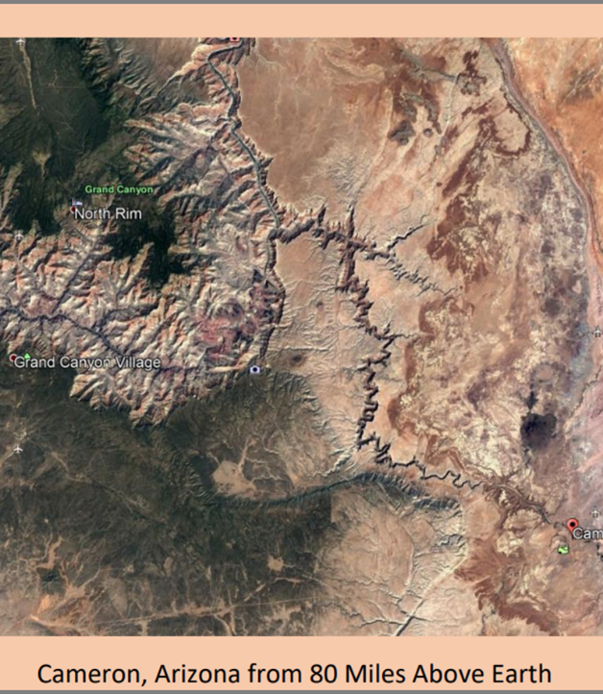
Envision Cameron
What do we want Cameron to look like in 2070?
$215,000 Federal Grant from USDA Rural Development
27

Slide 28
$150,000 grant award from USDA Rural Development for Navajo Business Planning and Business Start-up
Business Assistance for Navajo Entrepreneurs
28

Slide 29
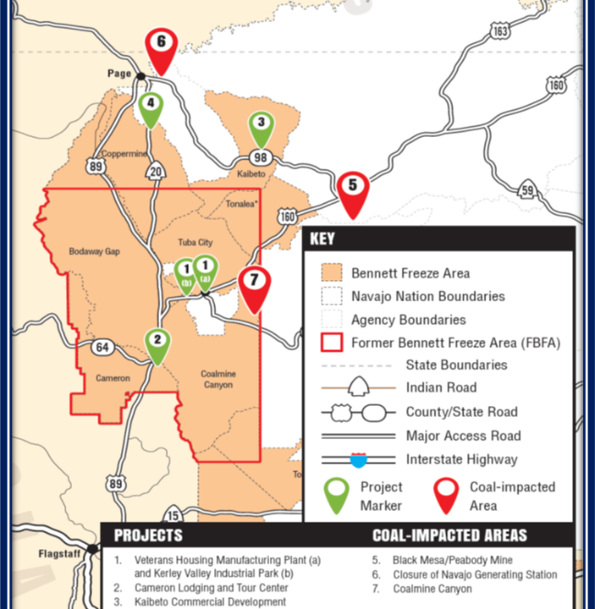
Pending Grant Applications with AML Grant Program
29

Slide 30
More Grant Application in the Works
30

Slide 31
The Bennett Freeze has Always Been a Stated Priority for the NNC
31

Slide 32
The Bennett Freeze has Always Been a Stated Priority for the NNC
In 2015, the Navajo Nation Council came to Tuba City to focus on the Bennett Freeze.
32

Slide 33
The Bennett Freeze has Always Been a Stated Priority for the NNC
In 2015, the Navajo Nation Council came to Tuba City to focus on the Bennett Freeze.
Their conclusion:
“We want to help you right now!”
33

Slide 34
FOUR PART PRESENTATION
1—Purpose
2—Request
3—Progress
4—Plan
34

Slide 35
FOUR PART PRESENTATION
1—Purpose
2—Request
3—Progress
4—Plan
35

Slide 36
FOUR PART PRESENTATION
The complete Plan can be viewed and downloaded at www.NavajoThaw.com
36

Slide 37
FOUR PART PRESENTATION
The following slides show
“representative sections”
of the plan
37

Slide 38
FOUR PART PRESENTATION
When fully implemented, this plan will not only bring housing, infrastructure, public facilities and an economy to the largest Indian Nation in the United States…
38

Slide 39
FOUR PART PRESENTATION
When fully implemented, this plan will not only bring housing, infrastructure, public facilities and an economy to the largest Indian Nation in the United States…
…it will allow a sovereign nation to build its own future.
39

Slide 40
40

Slide 41
41

Slide 42
116-page Plan…
Recovery Plan
Executive Summary
Funding Request
History and Impact
Chapter Plans
Building an Economy
Immediate Recovery Projects
Capacity and Organization
Building an Economy
Agriculture
Environmental Restoration
Health Care
Housing
Public Safety
Renewable Energy
Telecommunications
Transportation
Travel and Tourism
Water Infrastructure
42

Slide 43
THE FULL PRESENTATION
The Navajo Thaw Support Team
is always prepared to present
the Full Plan.
43

Slide 44
44

Slide 45
Time to Thaw the Freeze
45

Slide 46
Time to Thaw the Freeze
46

Slide 47
47

