Slide 1
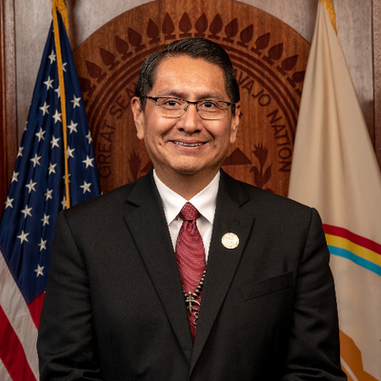
Jonathan Nez
Navajo Nation President

Slide 2
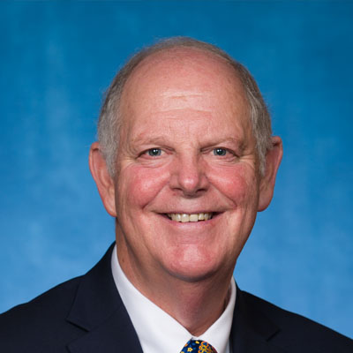
Tom O’Halleran
Congressman

Slide 3
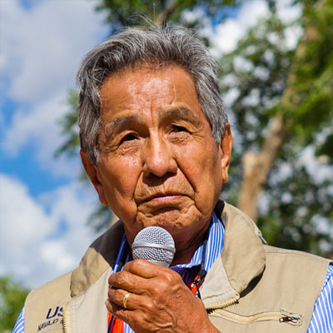
Peter MacDonald
Former Chairman

Slide 4
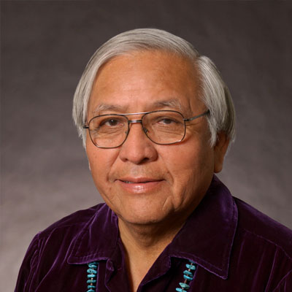
Peterson Zah
Former President

Slide 5
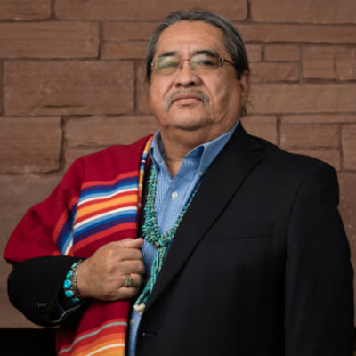
Manley Begay
Northern Arizona University

Slide 6
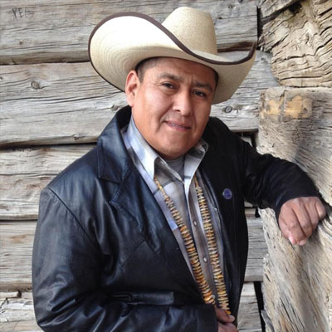
Otto Tso
Delegate

Slide 7
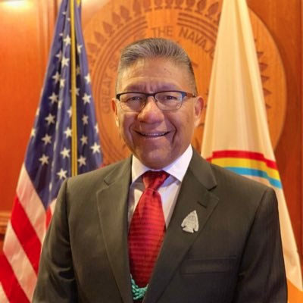
Myron Lizer
Navajo Nation Vice President

Slide 8
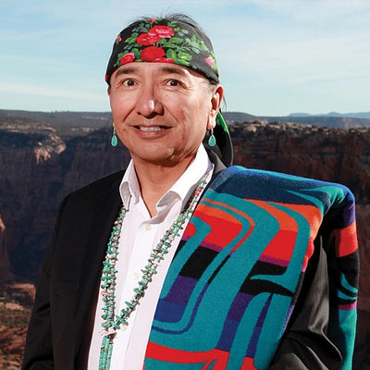
Rex Lee Jim
Special Advisor
to the President

Slide 9
Tonalea Red Lake Chapter
President Sarah Slim

Slide 10
Nahata Dziil Commission Governance
Commissioner Darrell Tso

